Slide 1
Unblocking Benefits of Public Participation in Decision Making: Panel 1: Public Participation that Delivers
Promoting Public Participation in Policy Making Through the Principles of Public Administration
Bagrat Tunyan
Senior Adviser, OECD/SIGMA
Vienna City Hall
11 June 2018

Slide 2
What is SIGMA?
SIGMA - Support for Improvement in Governance and Management - is a joint initiative of the OECD and EU, principally financed by the EU.
Active for more than 25 years, working with EU accession countries and, since 2008, European Neighbourhood countries.
Our overall objective is to support public governance reforms and strengthen the capacity of public administrations through enhancing horizontal governance and improving the design and implementation of public administration reforms.

Slide 3
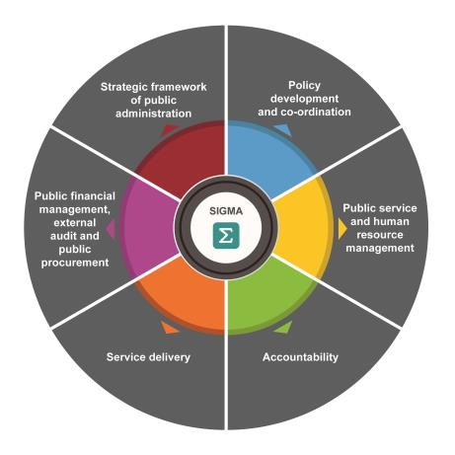
Principles of Public Administration:
48 Principles in 6 Core Areas
12 Principles in PDC Area, covering:
Policy planning and co-ordination / Centre of Government functioning
Policy development:
  P10- Evidence-based policy making
  P11- Public consultation on public policy

Slide 4
How do we promote public consultation?
Thorough regular assessment of partner countries against the Principles which also provide policy recommendations that cover policy development area.
  2015- Baseline Measurement assessment
  2017 -Monitoring Assessment in all IPA countries
  2018- Baseline Assessments in Georgia (PDC) and Ukraine.
SIGMA also supports partner countries to improve the regulatory framework and implementation of public consultation and evidence-based policy making.
Awareness raising, thematic and regional studies.

Slide 5
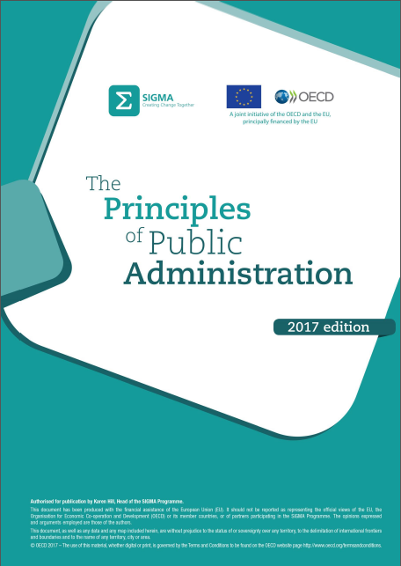
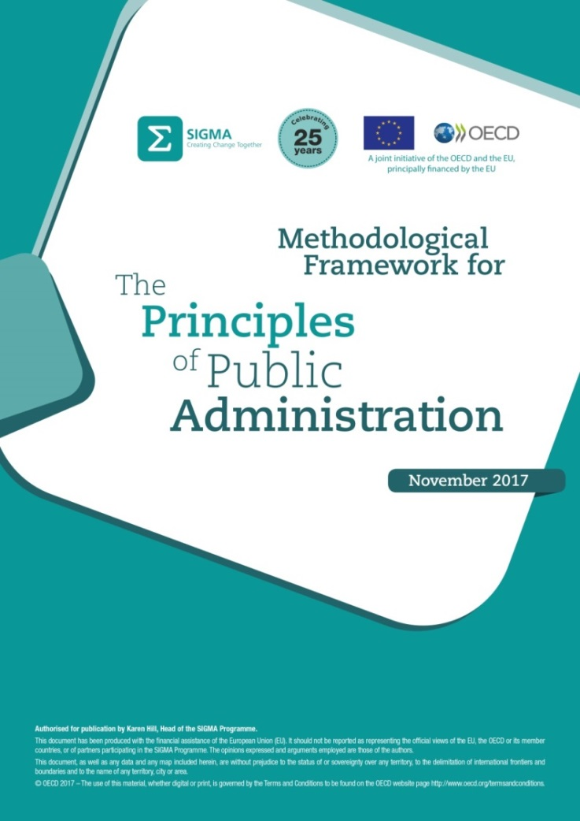
Evidence-based Measurement Framework
Notes:
-

Slide 6
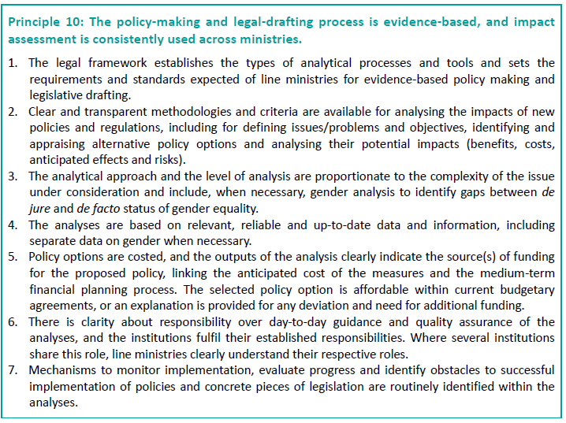
P10: Evidence-based policy making

Slide 7
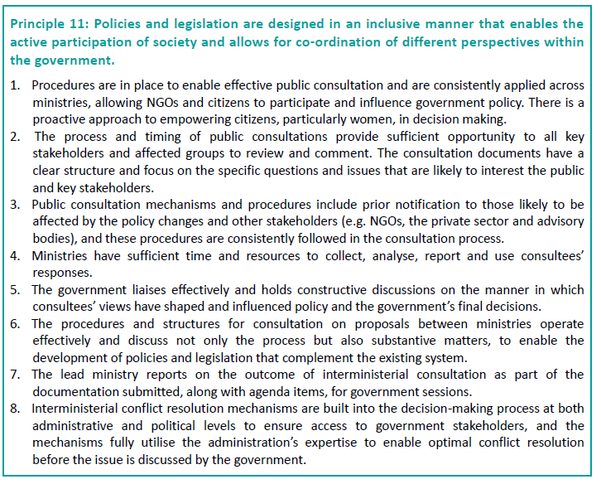
P11: Public consultation

Slide 8
Main requirements for good public consultation
Regulations and procedures should enable effective public consultation and should be consistently applied.
The process and timing of public consultations as well as the structure of the consultation documents should enable all key stakeholders to review and comment in a meaningful way.
Public consultation mechanisms and procedures should include prior notification to those likely to be affected.
Ministries should have sufficient time and resources to collect, analyse, report and use the feedback and responses.
The government should hold constructive discussions on the manner in which consultees’ views have shaped the policy and the government’s final decisions.
Public consultation should be integrated within the existing policy making cycle and process.

Slide 9
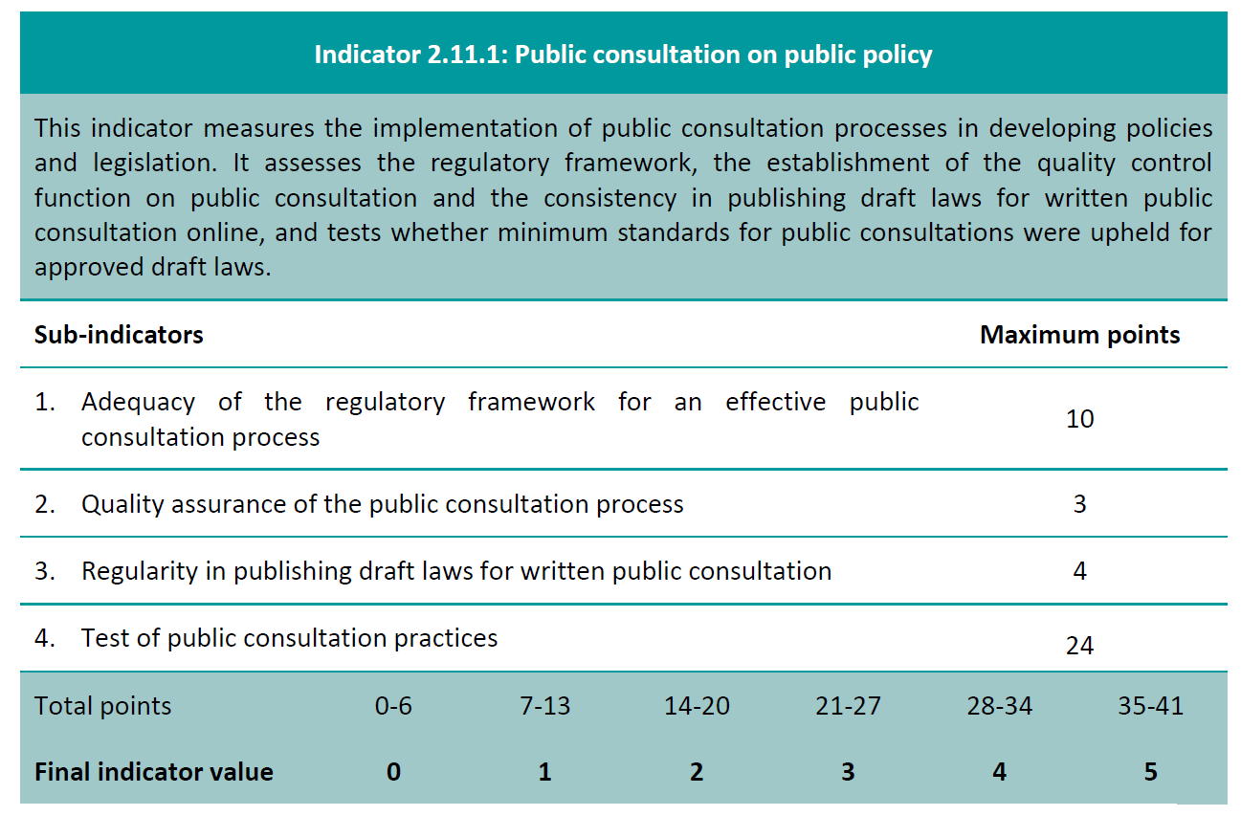
How do we actually measure public consultation in public policy (P11)?
Notes:
-Framework

Slide 10
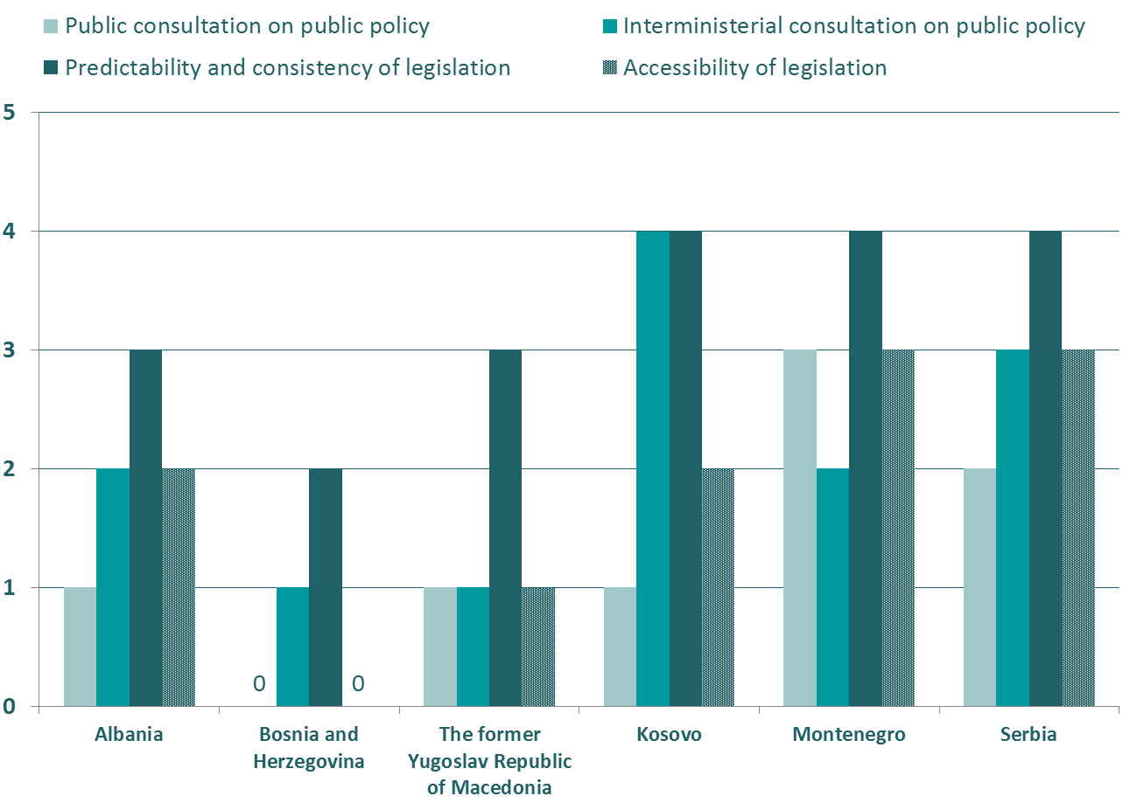
2017 SIGMA Monitoring Assessments:
Public consultation, consistency and accessibility of laws
WB countries performing below the average value of the indicator for public consultation.
*
*This designation is without prejudice to positions on status, and is in line with UNSCR 1244/1999 and the ICJ Opinion on the Kosovo declaration of independence.

Slide 11
2017 SIGMA Monitoring Assessments:
Key Findings in Public Consultation Area
Public consultation is still not forming an integral part of the policy making and legislative drafting process in WB countries.
Policy development is primarily seen as a legislative drafting task. There is limited analysis of policy measures contained in draft laws and their possible impacts on all stakeholders.
Basic regulatory framework enabling public consultation exists in most WB countries, but application of those rules is poor.
Procedures, systems and IT platforms for public consultation are often incomplete and do not facilitate effective consultation.
No evidence that the outcomes of public consultation are considered in the final design of policies and decision making.
Oversight and support mechanisms in the relevant CoG institutions are weak/non-existent in most countries. This does not ensure effective and consistent implementation of rules.

Slide 12
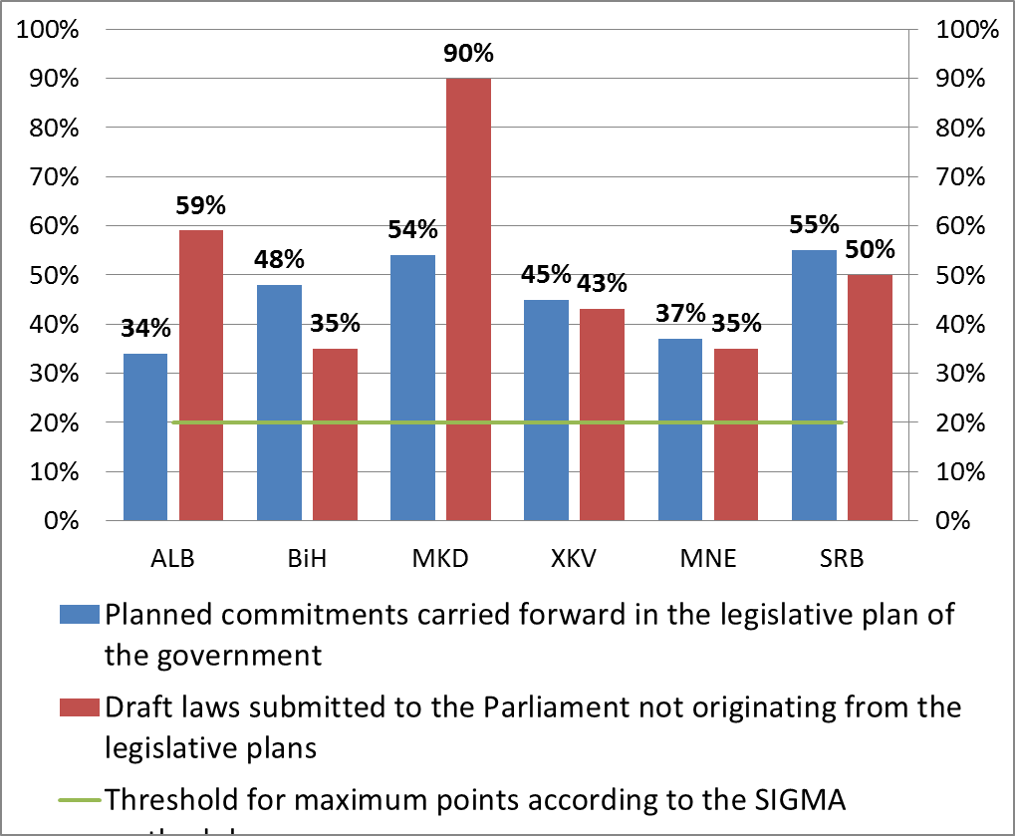
Weak legislative planning:
Many laws are initiated outside the plans
  Insufficient time and resources for ministries to prepare, plan and conduct public consultation. Stakeholders and citizens are not getting advance notice and sufficient time to plan and participate in consultations.

Slide 13
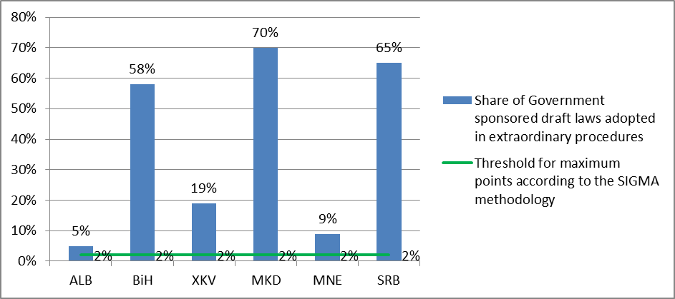
Laws adopted in extraordinary proceedings
Many laws are processed through extraordinary proceedings limiting the opportunity for any meaningful consultation with wider stakeholders and affected groups.

Slide 14
Implementation of public consultation rules remains a major challenge
Legal framework enabling public consultation exists in most countries. But implementation is poor.
 | ALB | BiH | MKD | XKV | MNE | SRB
Advance notice about upcoming consultation to stakeholders | Not required | Not required | Not followed | Partly followed | Partly followed | Not followed
Minimum duration for public consultations | Not followed | Not followed | Not followed | Not followed | Partly followed | Partly followed
Report prepared on the outcome of consultations | Not followed | Not required | Not followed | Not followed | Followed | Not followed
The report on the outcome of consultations published | Not required | Not required | Not followed | Not followed | Partly followed | Not followed
Supporting documents made available together with the draft legislation | Not followed | Not required | Not followed | Not followed | Not required | Not followed

Slide 15
Some key recommendations
More efforts and resources are needed to improve the actual implementation of the existing public consultation rules.
  Establish/strengthen the oversight and support function for public consultation to ensure the rules and requirements are followed.
  Provide additional guidance and regular training for ministries.
  More realistic legislative planning is needed; reduction in the use of extraordinary proceedings in legislative drafting.
Change in culture within the administration is needed to ensure all participants of the public consultation process understand and value the process and use it to improve policy.
Ensure any public consultation is focused on discussing the policy measures and content, not the legal provisions and drafting techniques. Facilitate consultation by publishing supporting materials, such as RIA reports and separate consultation documents.
Ensure that requirements and rules for public consultation are fully aligned within the main policy-making processes. Avoid creating parallel processes in policy making.

Slide 16
Thank you.
For more information:
bagrat.tunyan@oecd.org
www.sigmaweb.org

